Slide 1
Emergency Supply Organizer
By: Cole Tyler and Aaron Jimenez

Slide 2
Team norms
• Input from all team members
The input from us is that we are going to work on everything together. We think that doing things on our own will be difficult. So we decided to work to work on everything.
• Team meeting schedule and project timeline
We don’t exactly know how much time it’s going to complete the final product or all the parts. We “plan” on finishing each part every two days. So on the end of the second day, we should be done with a part. Or maybe even sooner than that.
• Communication protocols
We plan to communicate outside of school via text message and phone call. Inside of school, we have all the same classes so it will be easy to communicate in school.
• Conflict resolution protocols
If we get stuck on something, we plan to ask another group for their opinion. Or the teacher at that.

Slide 3
Problem Statement w/ constraints
Problem Statement: Even when placed carefully in the trunk of a car, emergency supplies and other items slide around and shift positions. Many times these products are damaged or fall into the crevices of the spare tire compartment.
Constraints: 1. Must not attach to any part of the car.
2. Must fit within a box with interior dimensions of 14 in. wide x 12 in. deep x 10 in. high.
3. Must be an assembly of a minimum of six different parts.
4. Must hold a minimum of seven items.
5. Must be made of a durable material.

Slide 4
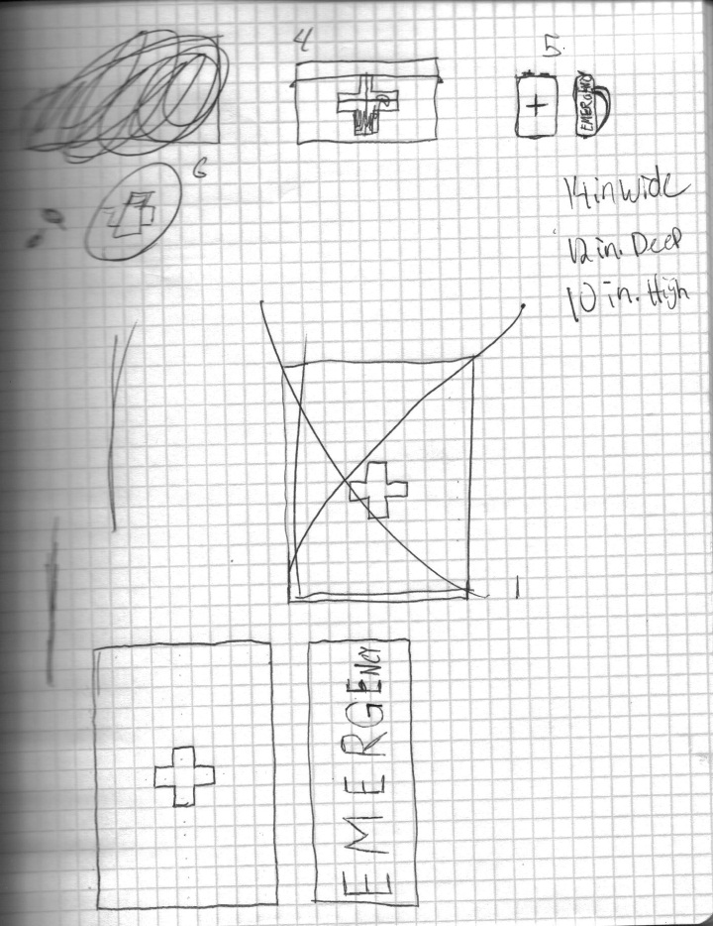
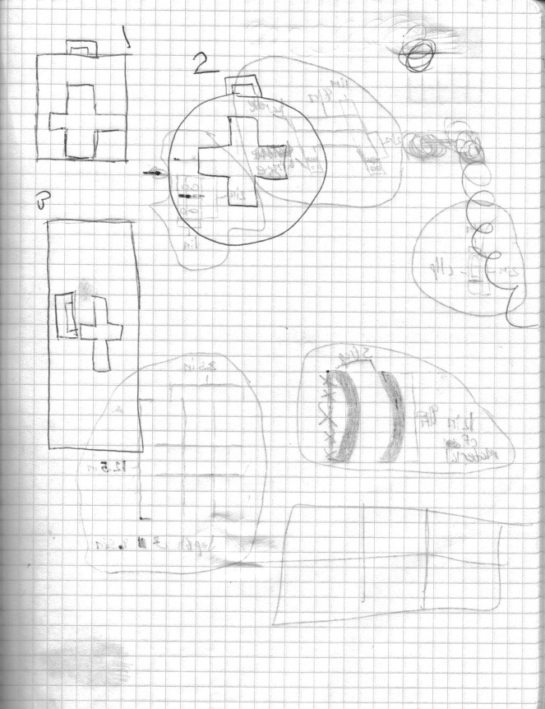
Brainstorm Sketches

Slide 5
Design MAtrix
 | Criteria
Ideas | Appearance? | Easy To Make? | Durability? | Efficiency? | Easy to Access? | Weight? | Totals
Idea #1 | 1 | 3 | 4 | 3 | 3 | 2 | 16
Idea #2 | 1 | 2 | 2 | 3 | 2 | 2 | 12
Idea #3 | 2 | 1 | 4 | 4 | 1 | 1 | 13
Idea #4 | 3 | 3 | 4 | 2 | 3 | 1 | 16
Idea #5 | 4 | 3 | 3 | 4 | 4 | 3 | 17
Idea #6 | 1 | 3 | 3 | 2 | 2 | 2 | 13

Slide 6
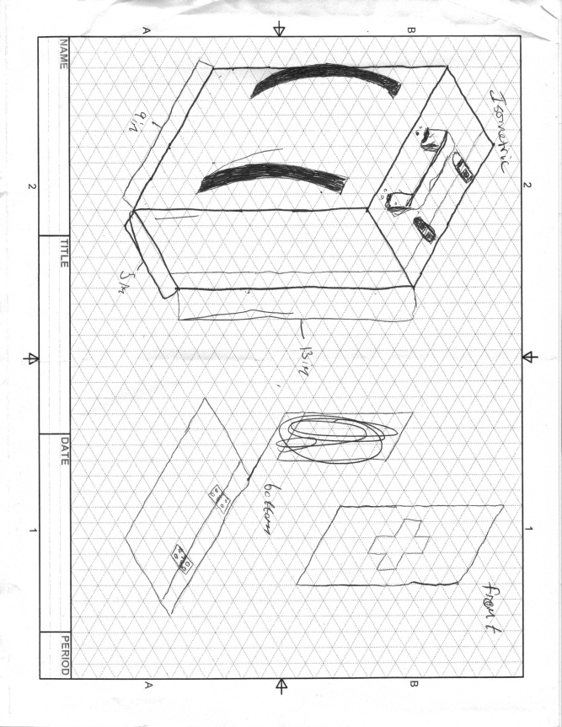
Detailed Sketch

